Slide 1
THE DICTIONARY LE DICTIONNAIRE
GROUP MEMBERS: MOHAMMAD AHSAN SIDDIQUi (18076), hassan ANWAR RAJPUT (18072) and Nimra ASLAM MOTEN (14815).

Slide 2
WHAT IS THE GOAL?
The goal was to design a dictionary that could be used by English speakers who are learners of French language AND also by the French speakers who are learners of English language.
This means that the application should contain instructions in English for English speakers who are using the application to find out meanings of French words in their language; and the application should also contain instructions in French for French speakers who are using the application find out meanings of English words in their language.

Slide 3
DATA STRUCTURES USED
Two Hash Tables – one for English words and the other for French words.
Singly Linked List – to store number of collisions of each word during insertion inside Hash Table and also to test separate chaining approach.

Slide 4
VISUAL DEPICTION OF EACH NODE OF HASH TABLE
English Meaning
French Meaning
English Word
French Word
Type
VISUAL DEPICTION OF EACH NODE OF SINGLY LINKED LIST
Number of collisions
Next Node Address
Word

Slide 5
VISUAL DEPICTION OF SINGLY LINKED LIST
Word
Number of collisions
Next Node Address
Word
Number of collisions
Next Node Address
Word
Number of collisions
Next Node Address

Slide 6
ENGLISH WORDS HASH TABLE
FRENCH WORDS HASH TABLE
0
0
1
Hashing with French word gave this index (6) of the hash table to put reference of the node
1
THIS IS THE NODE SHOWN ON SLIDE 4
2
2
Hashing with English word gave this index (1) of the hash table to put reference of the node
EW
FW
EM
FM
Type
3
3
4
4
5
5
6
6
7
7

Slide 7
HOW IS THE DATA ‘DUMPED’ WHEN THE APPLICATION RUNS?
A class ‘Data’ contains two objects of class ‘HashTable’; both of these are of type ‘Node’.
One of these Hash Tables puts REFERENCE for each node by calculating index value for it using the English word inside it. Sum of the asci codes of characters inside the String value of “English Word” is modded with size of the Hash Table in order to calculate an index value. This Hash Table is employed to search meanings of English words when they are entered by the user.
The other Hash Table does the same, but uses the “French Word” to hash and calculate index value. This Hash Table is employed to search meanings of French words when they are entered by the user.

Slide 8
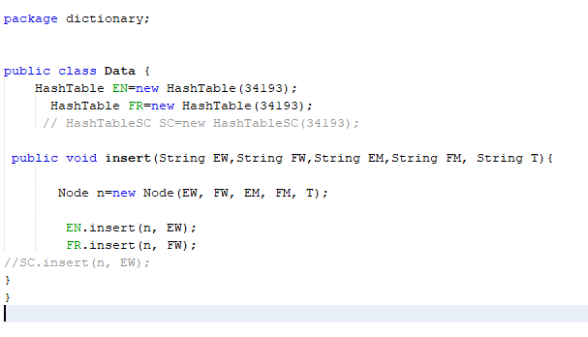
A GLIMPSE OF DATA CLASS

Slide 9
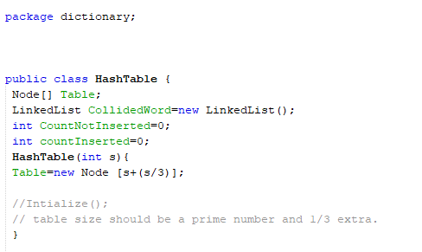
A GLIMPSE OF HASH TABLE CLASS
Singly Linked List to store words and their number of collisions during their insertion in Hash Table.

Slide 10
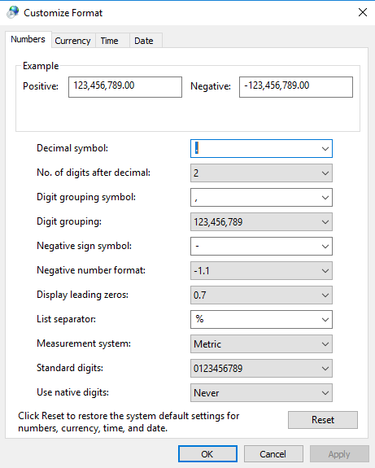
WHERE IS THE DATA STORED FROM WHERE THE APP READS IT?
The data is stored inside a CSV file that contains all the data. It was a challenge to work with CSV files in this case with their default settings. CSV files are “Comma delimited”, means that the columns inside these files are separated by commas. Therefore, using split method of String class in Java with a “,” as splitting criteria would have caused split even at those points in a line of text file where it was not desired.
Therefore, in order to tackle this problem, the column separator symbol was changed to “%” symbol. This symbol had no occurrence inside the data and there was most suitable to be used for separating columns and causing split between the fields while reading the text file from the application.

Slide 11
DIFFERENT HASH AN REHASH APPROACHES EMPLOYED TO REDUCE COLLISIONS DURING INSERTION INSIDE HASH TABLES
SEPARATE CHAINING AND OPENING ADDRESSING TECHNIQUES WERE EMPLOYED TO FIND OUT WHICH APPROACH IS BEST FOR THIS DATA SET.

Slide 12
OPEN ADDRESSING TECHNIQUES EMPLOYED
Linear Probing
Linear + Quadratic Probing
Quadratic Probing
Quadratic Probing with addition of a Prime Number
Quadratic Probing with last two digits of the sum of asci values of characters inside word string.
NOTE: In order to check performance of each approach, each Hash Table contained a class object of Singly Linked List class that stored every word inserted inside the Hash Table along with number of collisions it had during the process.

Slide 13
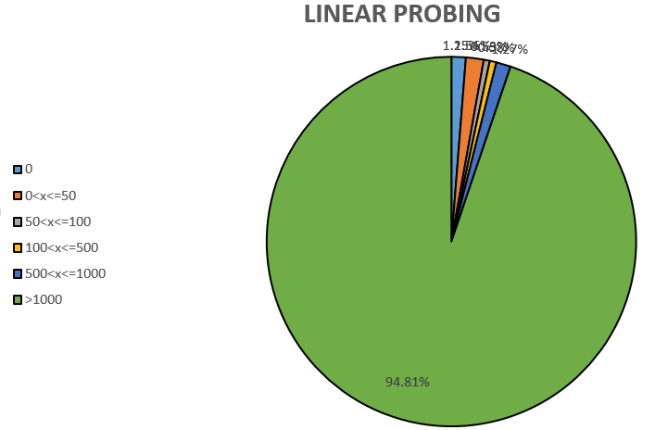
LINEAR PROBING
This was the worst approach for this data set. Notice that 94.81% of data has collisions above 1000!

Slide 14
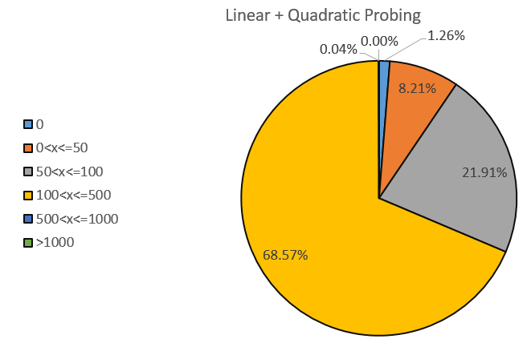
LINEAR + QUADRATIC PROBING
Performs far better than linear probing but quadratic probing alone performs slightly better than this technique.
In this technique, when a word has a collision, and when the iteration number is odd, linear probing rehash function is called and when the iteration number is even, quadratic probing rehash function is called.

Slide 15
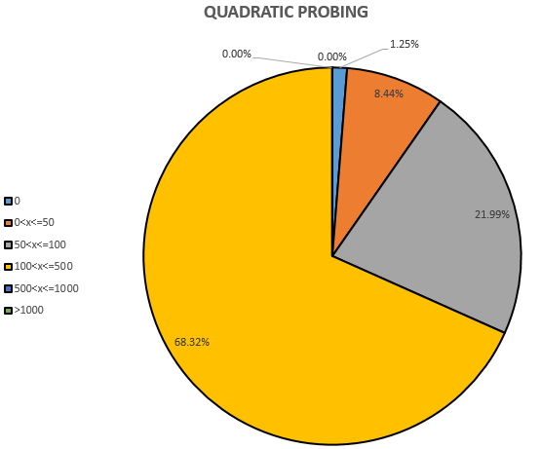
Quadratic Probing
Performs slightly better than Linear+Quadratic probing.

Slide 16
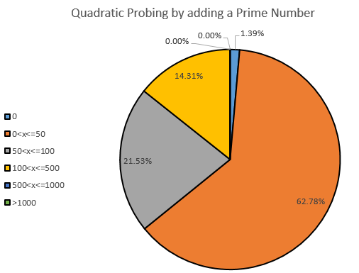
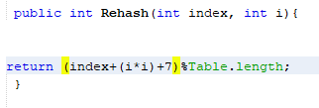
NOTICE the difference made by this approach. When the quadratic probing alone was used, 68% had collisions in the range 100<x<=500. By changing the rehash method to the one above, 62.78% of data now has collisions in the range 0<x<=50.

Slide 17
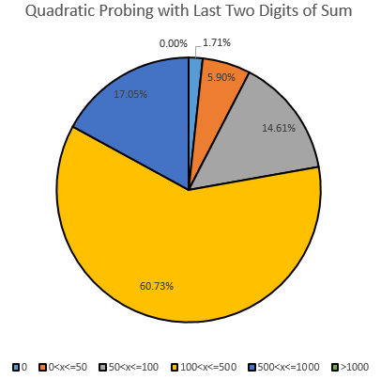
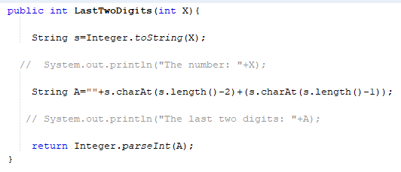
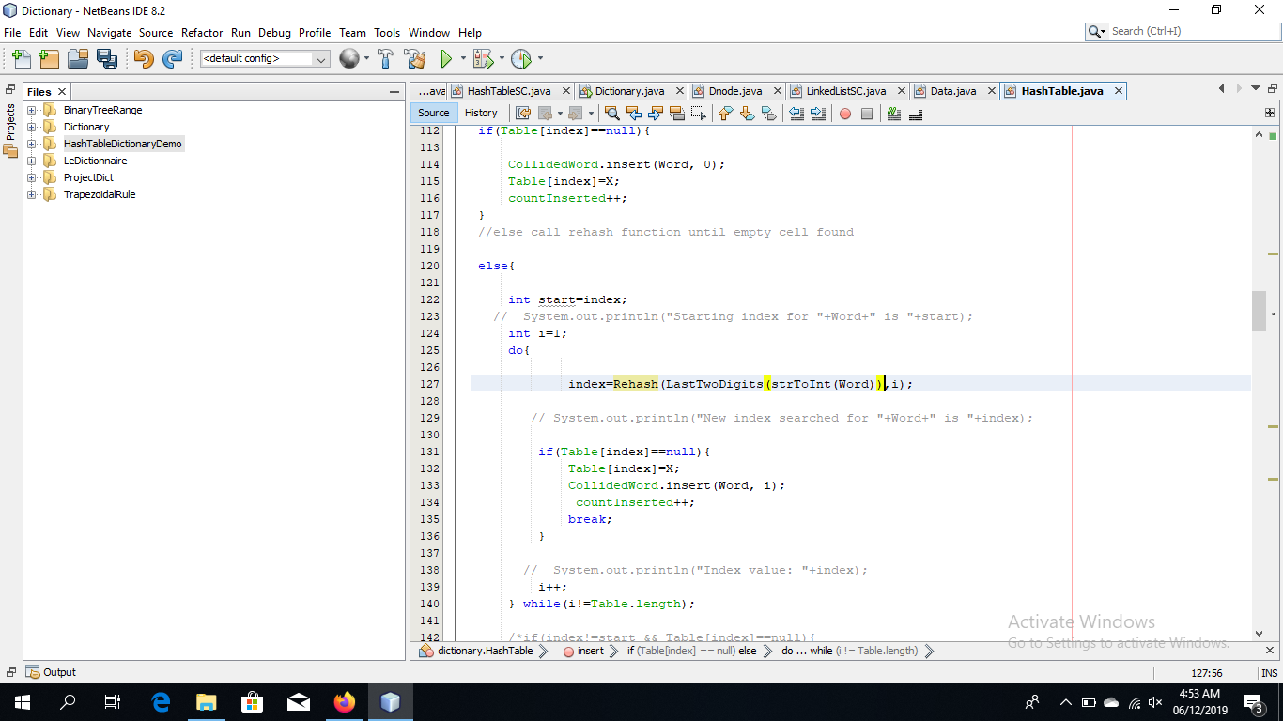

Slide 18
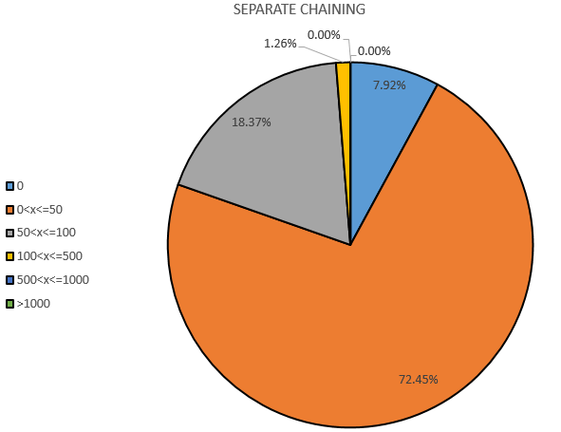
SEPARATE CHAINING
This approach performed best with our data set.
This graph has also taken into account the steps a word has to move to get inserted at the end of a Linked List emerging from a specific cell of Hash Table. Despite that, 72.45% of the data collides no more than 50 times.

Slide 19
VISUAL DEPICTION OF SEPARATE CHAINING TECHNIQUE
0
1
EW
FW
EM
FM
next
FW
FM
next
Type
EW
EM
Type
2
3
4
EW
FW
EM
FM
next
FW
FM
next
next
Type
EW
EM
Type
EW
FW
EM
FM
Type
5
6
EW
FW
EM
FM
next
7
Type

Slide 20
THE GRAPHICAL USER INTERFACE

Slide 21
WINDOWS USED
The applications runs on three windows in total:
The WELCOME window – that provides all the instructions to the users in both English and French.
French To English window – that opens up for users who want to find out meanings of French words in English. This window contains instructions in English because it is assumed that the users at this window know English and are here to learn French.
English to French window – that opens up for users who want to find out meanings of English words in French. This window contains instructions in French because it is assumed that the users at this window know French and are here to learn English.

Slide 22

Directs to French to English window
Directs to English to French window

Slide 23
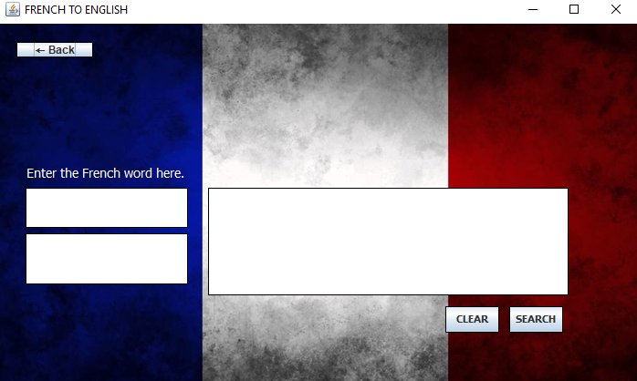

Slide 24
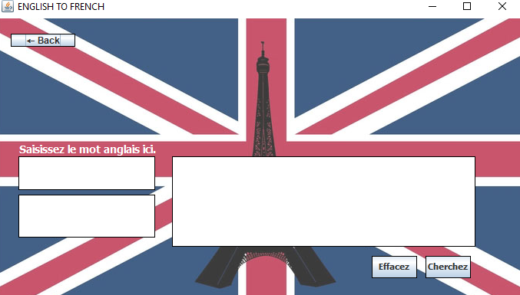
English word is entered here by the user
The meaning of the word given by the user appears here when the button “Cherchez” is clicked.
The type of word (noun, adjective, verb etc.) appears here
Clears all cells
Searches the word typed b y the user.

Slide 25
TECHNIQUES EMPLOYED FOR GOOD GUI EXPERIENCE
The data is ‘dumped’ only ONCE, that is when the application starts. The reference of the object of data class is then passed into objects of other windows so that the data can be accessed from there and there is “no delay” caused by dumping data again and again every time you go from one window to the other.

Slide 26
ADDITIONAL POINTS
The dictionary included more than 34 thousand words. We already had file containing English words and their meanings in English.
In order to find out French translations of those and their meanings, we used Google Sheets where it was possible to use a formula involving Google Translator and drag that down to apply it for all words and meanings.

Slide 27
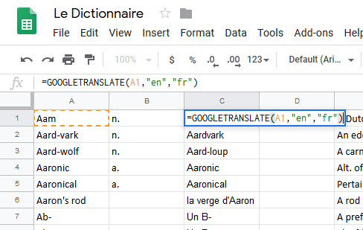
The translator formula used to translate each cell in column A and display its French translation in column C.

Slide 28
THANK YOU

